Slide 1
Groundwater Resources & Management in the CAPCOG Region

Slide 2
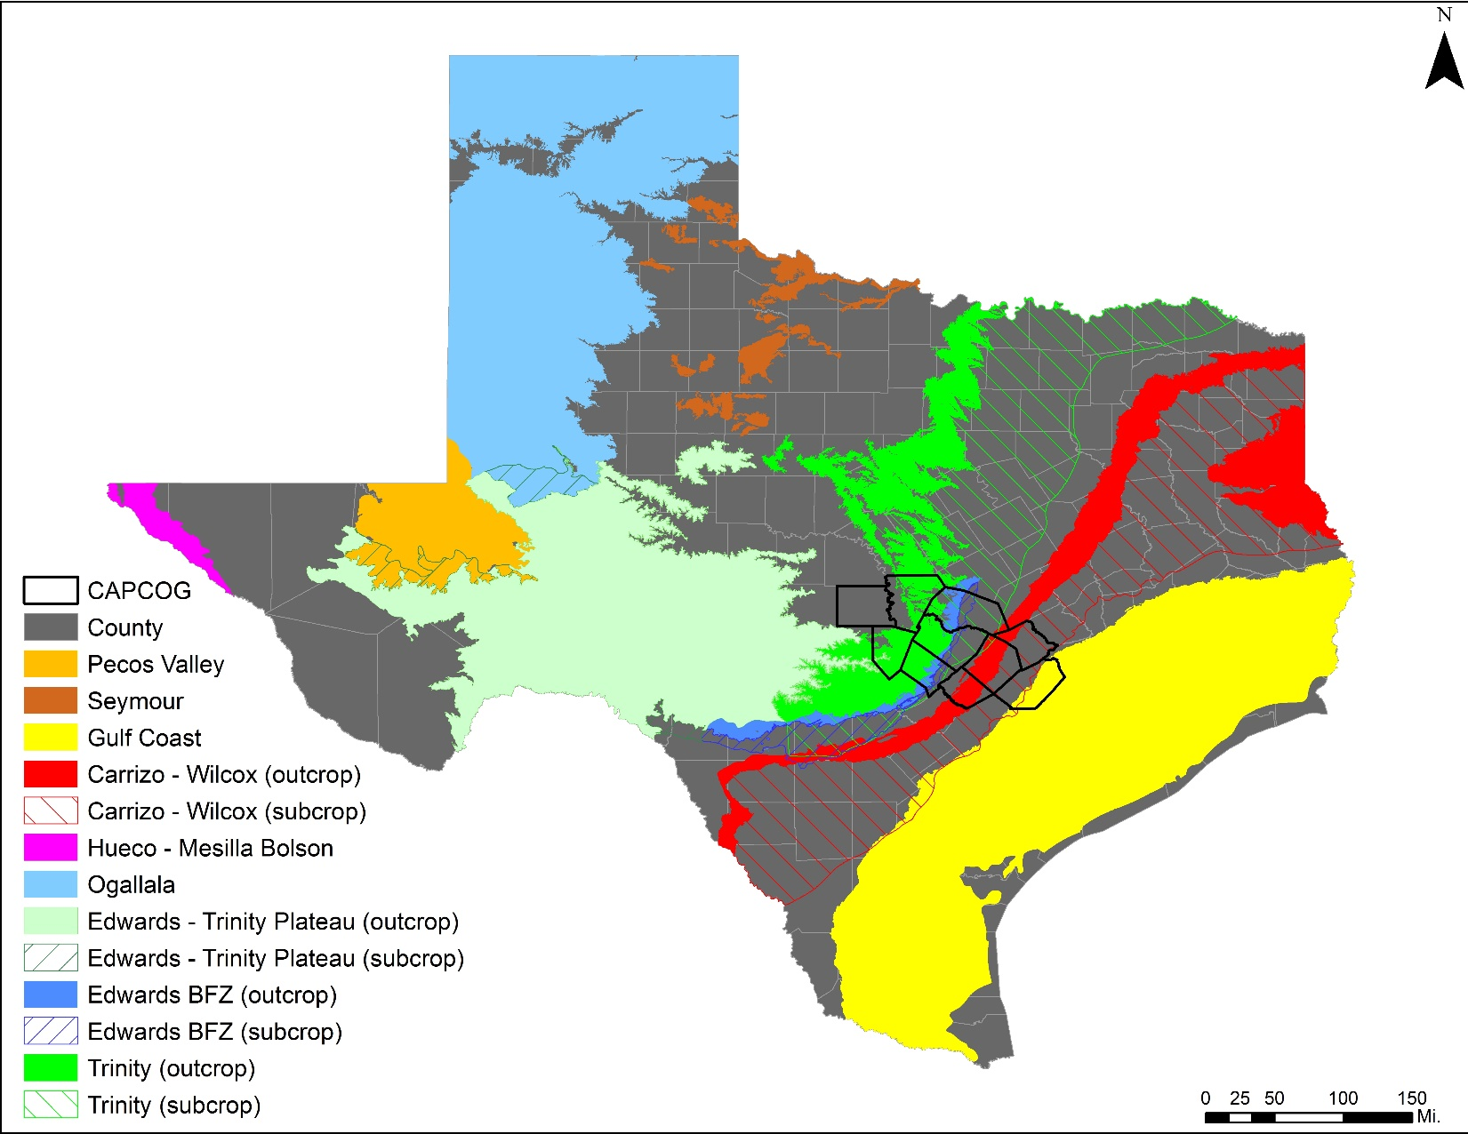
Major Aquifers
Notes:
Same colors used by the TWDB maps. 9 major aquifers in TX

Slide 3
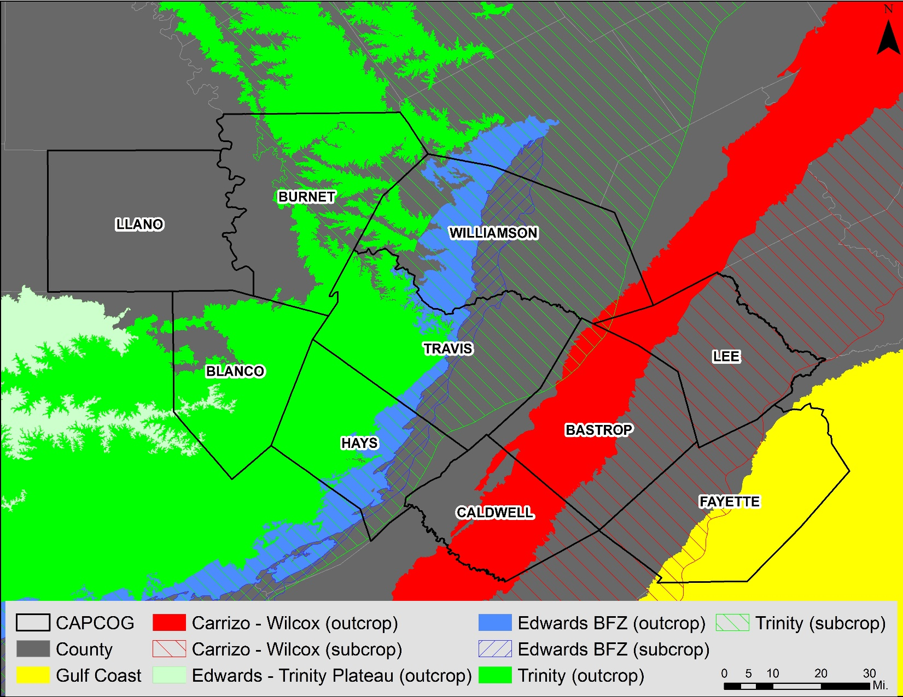
Major Aquifers in CAPCOG
Notes:
5 Major Aquifers in CAPCOG. Trinity covering the most area in the West and the Carrizo-Wilcox in the East.

Slide 4
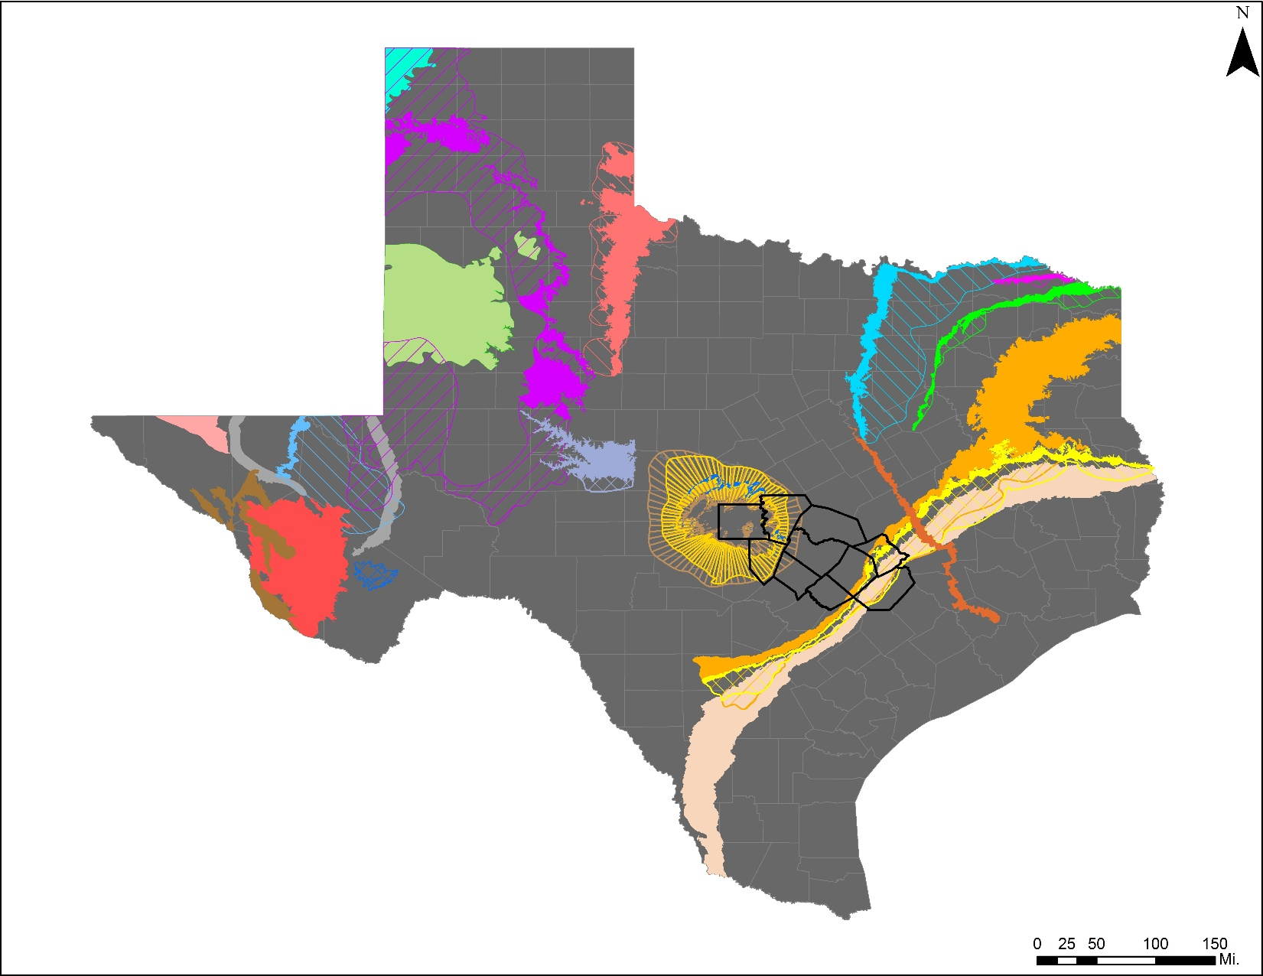
Minor Aquifers
Notes:
21 minor aquifers

Slide 5
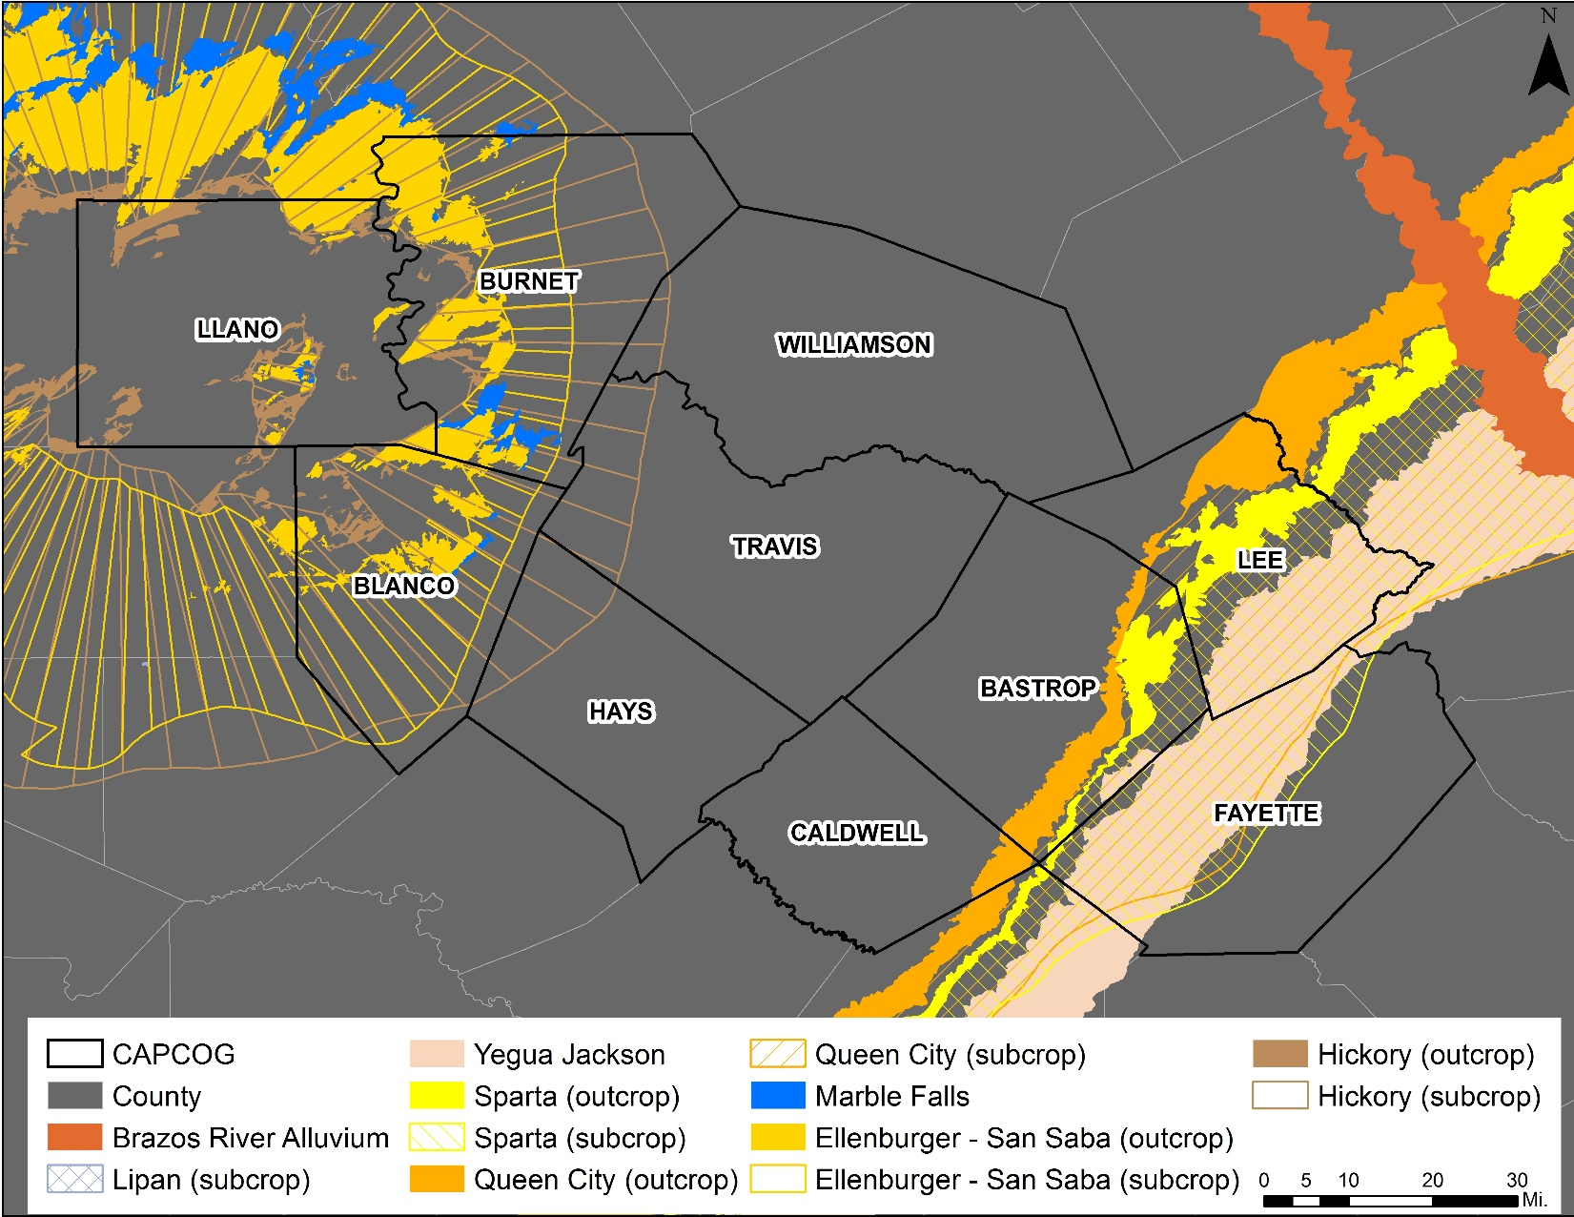
Minor Aquifers in CAPCOG
Notes:
8 Minor Aquifers in CAPCOG

Slide 6
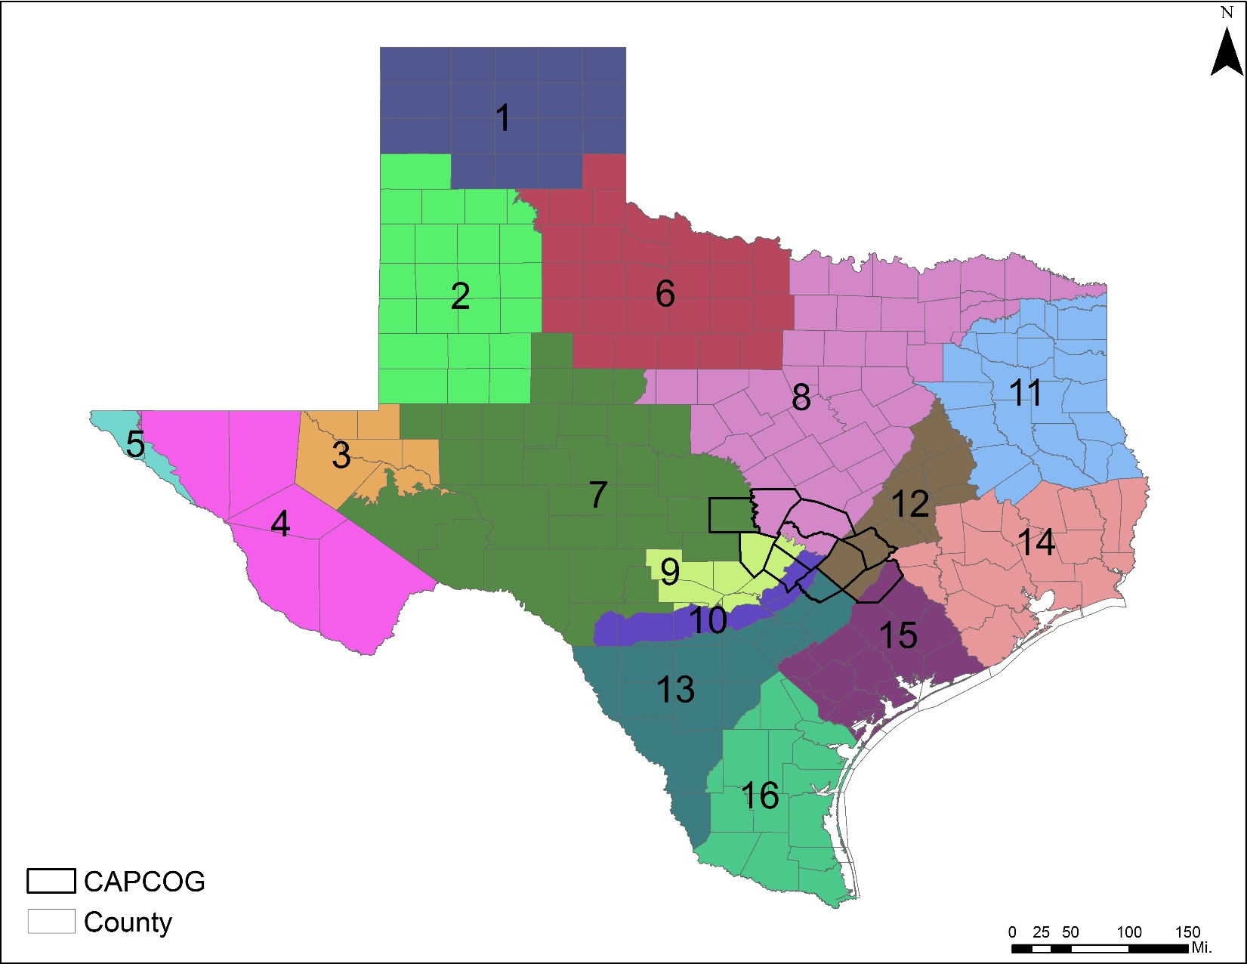
Groundwater Management Areas (GMA)
Notes:
16 GMAs. GMAs were created "in order to provide for the conservation, preservation, protection, recharging, and prevention of waste of the groundwater, and of groundwater reservoirs or their subdivisions, and to control subsidence caused by withdrawal of water from those groundwater reservoirs or their subdivisions”

Slide 7
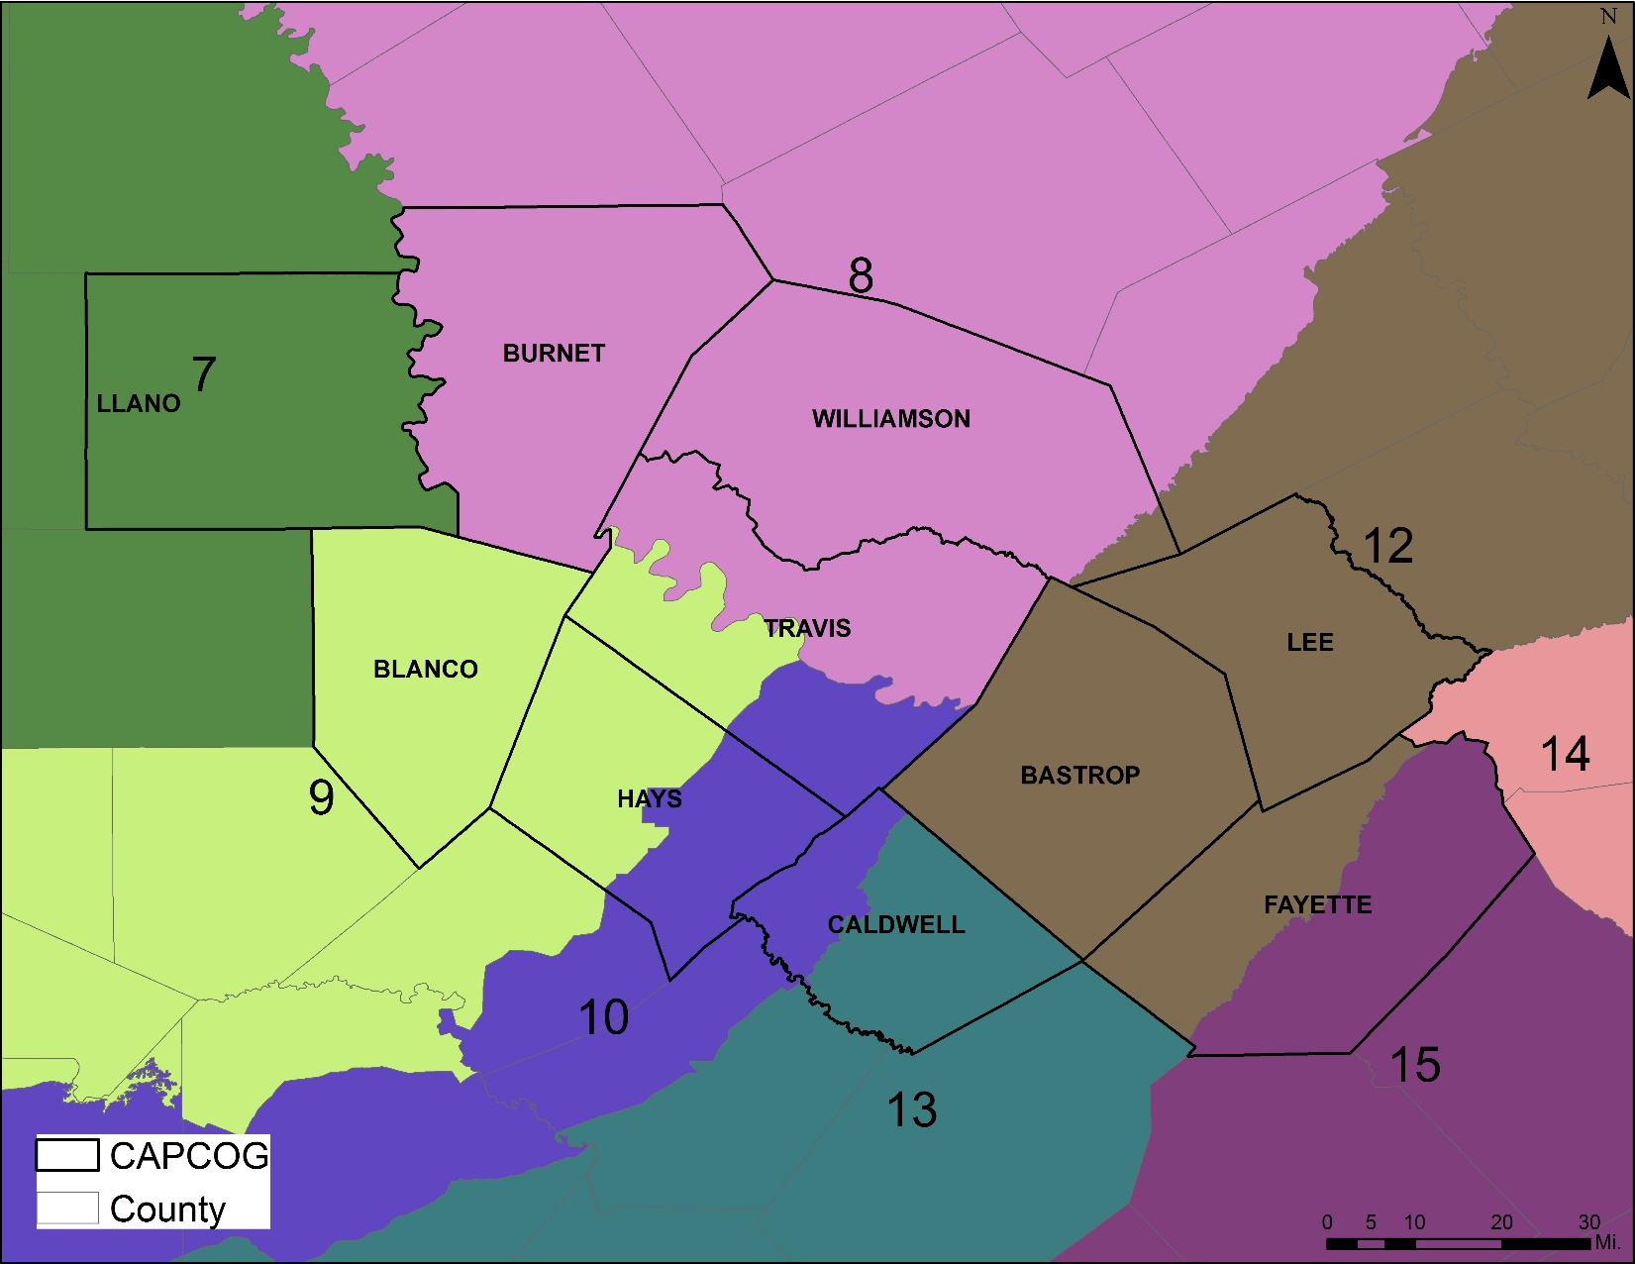
Groundwater Management Areas in CAPCOG
Notes:
7 GMAs in CAPCOG. #14 is close to the east.

Slide 8
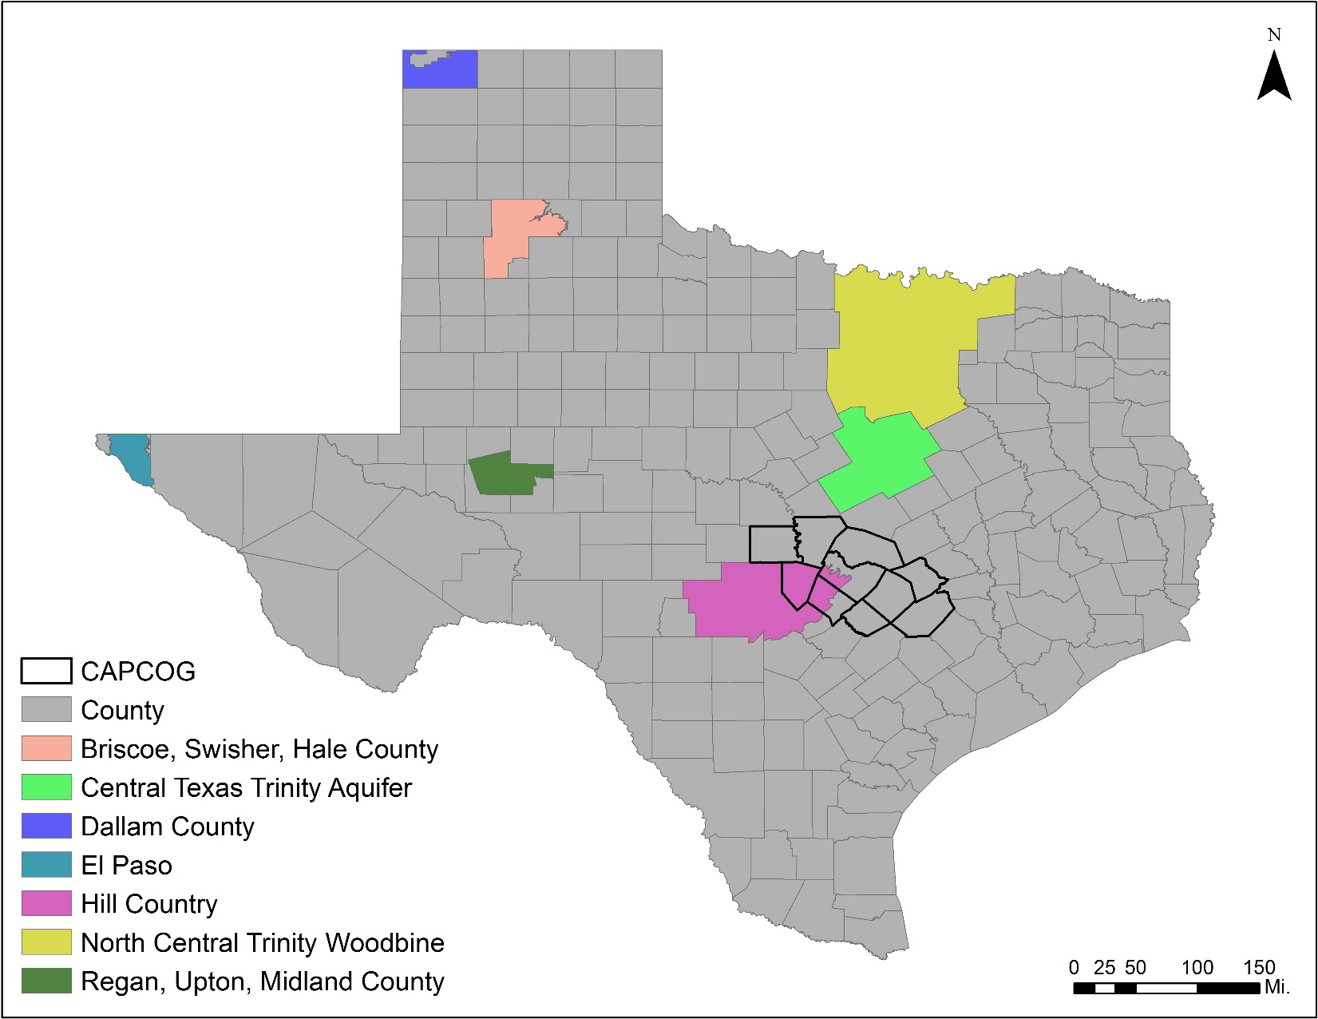
Priority Groundwater Management Areas (PGMA)
Notes:
7 PGMAs. PGMA is an area designated and delineated by TCEQ that is experiencing, or is expected to experience, within 50 years, critical groundwater problems including shortages of surface water or groundwater, land subsidence resulting from groundwater withdrawal, or contamination of groundwater supplies.

Slide 9
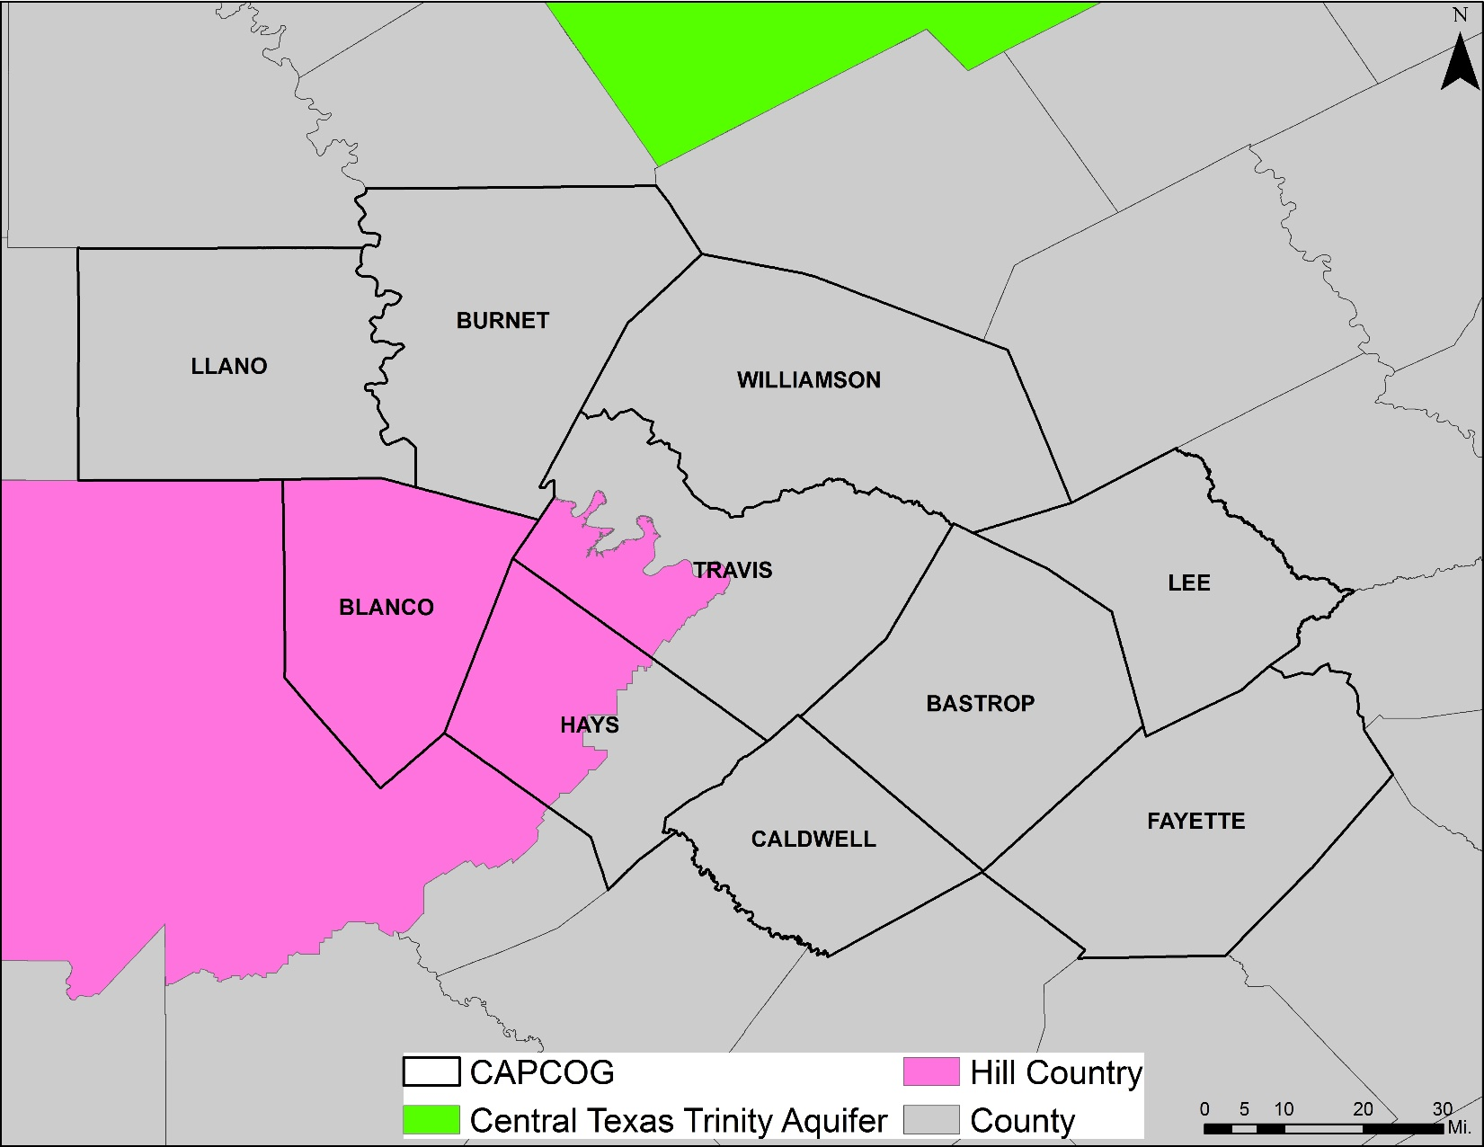
PGMAs in CAPCOG
Notes:
1 PGMA in CAPCOG- Hill Country, it covers all of Llano, half of Hays, and ¼ of Travis. Central TX Trinity close to the north. Both of these PGMAs overlay the Trinity Aquifer.

Slide 10
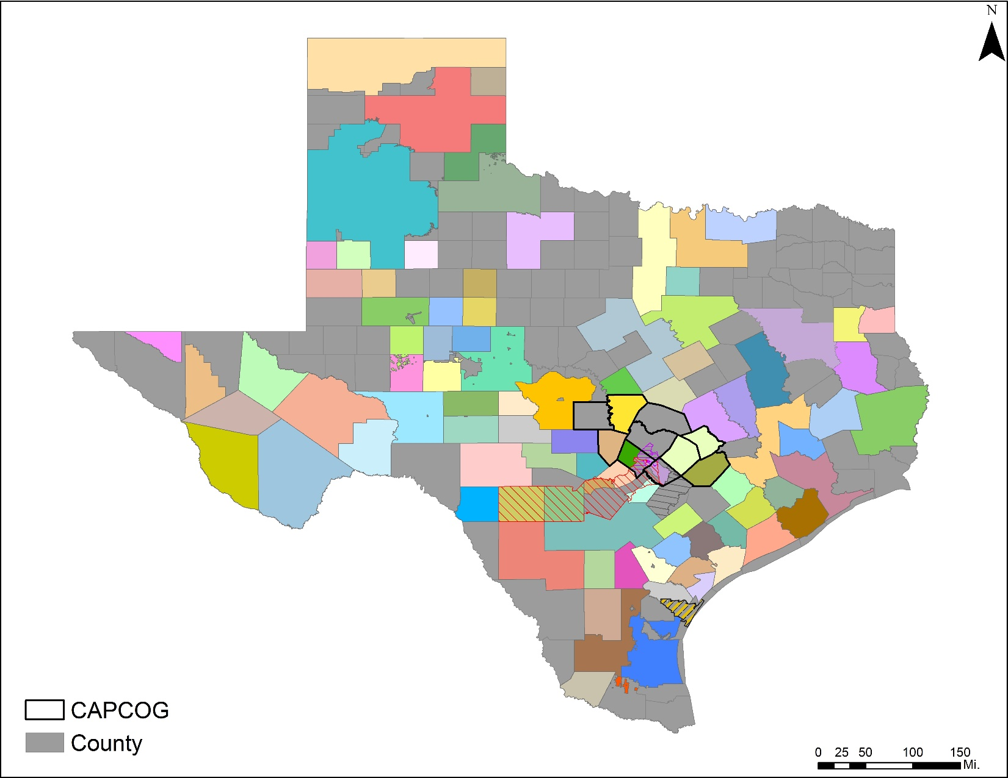
Groundwater Conservation Districts (GCD)
Notes:
The three primary GCD legislatively-mandated duties include: permitting water wells; developing a comprehensive management plan; and adopting the necessary rules to implement the management plan. 101 GCDS. Areas in gray do not have a GCD. GCDs are state's preferred method of groundwater management.

Slide 11
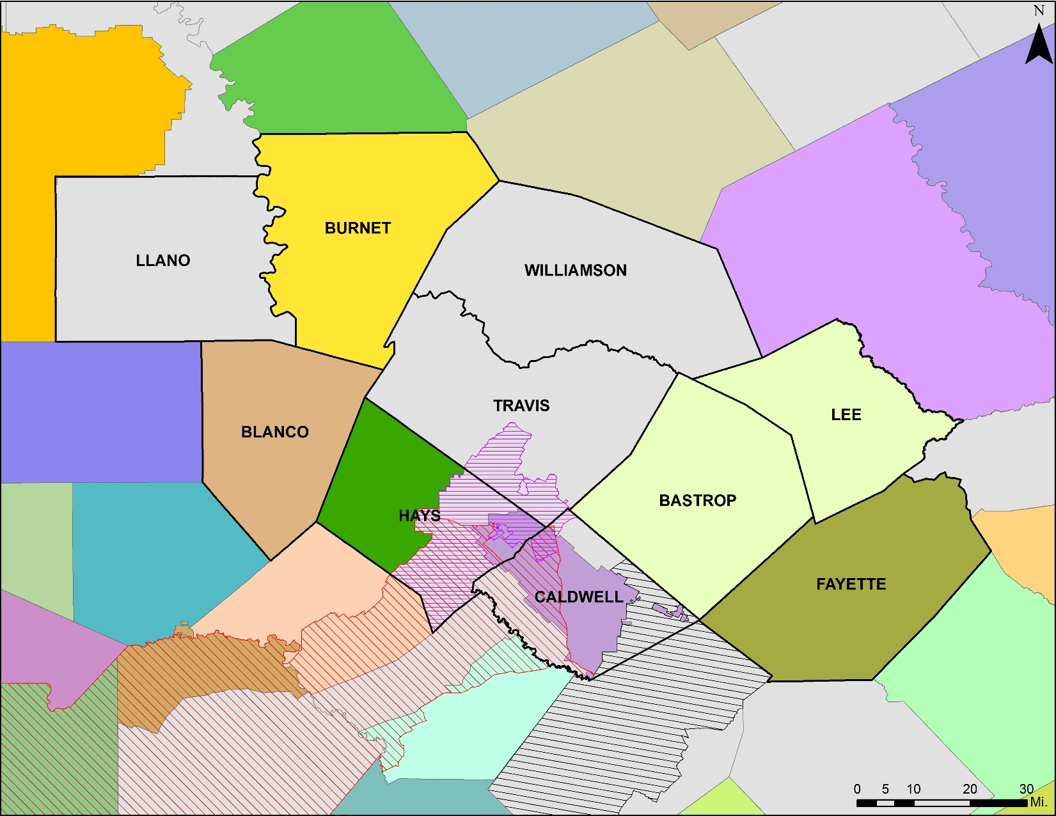
GCDs in CAPCOG
Notes:
9 GCDS in CAPCOG, Areas in gray do not have a GCD.

Slide 12
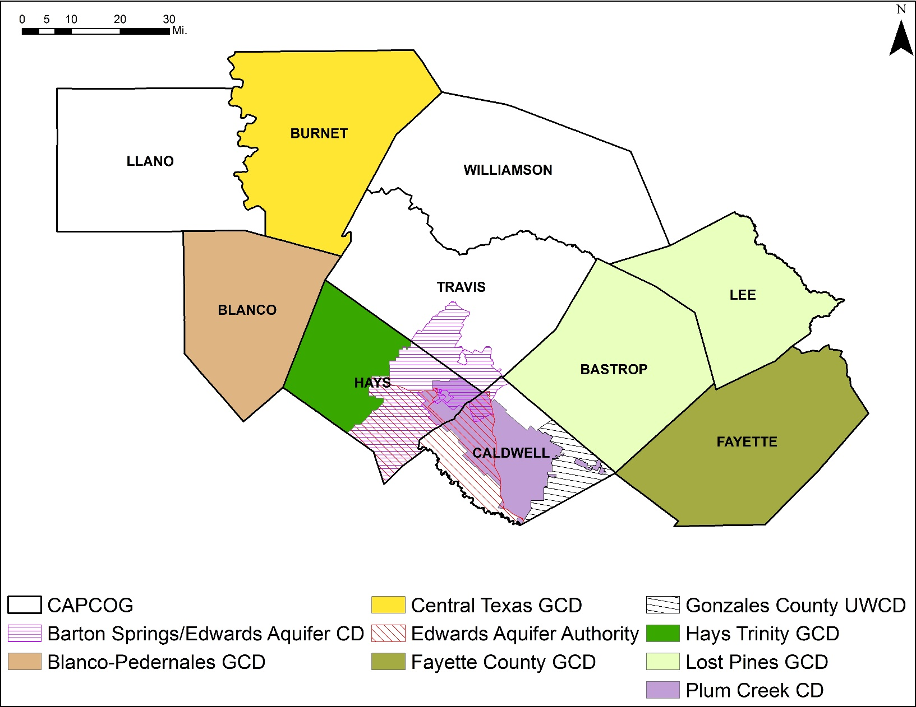
Areas in CAPCOG without a GCD
- All of Llano and Williamson Counties
- Majority of Travis County
- Part of Caldwell County
Notes:
Clipped to show just what is in CAPCOG for clarity

Slide 13
Existing Groundwater Supply by Aquifer
Notes:
Data from 2017 State Water Plan. Edwards-BFZ= Edwards-Balcones Fault Zone. Guadalupe River Alluvium is 53-59 acre-ft/yr, and Marble Falls is 174 acre-ft/yr. Major source is the Carrizo-Wilcox and Trinity.

Slide 14
Existing Groundwater Supply by County
Notes:
Bastrop County has the largest supply, with Hays Co second.

Slide 15
Future Groundwater Demands by Aquifer
Notes:
Two new sources of GW are from Edwards and Trinity Aquifer Storage and Recovery (ASR). ASR is the storage of water in a suitable aquifer through a well during times when water is available, and the recovery of water from the same aquifer during times when it is needed.

Slide 16
Future Groundwater Demands by County
Notes:
Burnet, Caldwell, Hays, and Travis will have more than doubled their demand from 2020 to 2070. Fayette’s demand goes down in the future. Lee Co does not have future demands= 0.

Slide 17
Summary
Caldwell, Llano, Travis, and Williamson Counties are lacking a GCD in some or all of the county.
The Carrizo-Wilcox Aquifer represents the largest source of existing groundwater supply and future demand.
Bastrop and Hays Counties have the most existing groundwater supplies.
Hays and Williamson Counties will have the largest future groundwater demand.

Slide 18
Thank you
Capital Area Council of Governments
www.capcog.org
Christiane Alepuz
calepuz@capcog.org
512.916.6005

